Slide 1



Chest X-ray Abnormalities Detection

Slide 2
Kulkarni Ganesh Shivajirao
ED16B016
InuAid Solutions Pvt.Ltd
Guide : Ganapathy Krishnamurthi

Slide 3
Findings
Imbalance dataset resulting model to train for some categories only
Single trained model not able to improve score
Validation dataset is not helping for training
Used partial classes dataset, score improved to 0.192

Slide 4
Previous Results
Test each model on Kaggle test data
Found score range of 0.13 to 0.16
Generated results with Ensemble method
Found public score : 0.243
Private score: 0.274

Slide 5
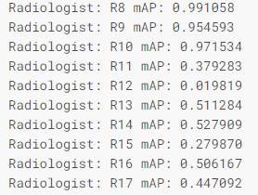
Findings
K Fold and ensemble method found to be effective
Implemented class based fusing
mAP values of corresponding radiologist

Slide 6
Stage 2 YoloV5
Images from R8’, ‘R9’ and ‘R10’ radiologists are removed from previous K fold
Boxes was tripled using 3 variants of boxes for remaining annotations
Trained updated dataset with previous K fold trained model
Learning rate was decreased from default 0.01 to 0.0005

Slide 7
YoloV5 Model
Batch Size 40
Image Size 640
Optimizer SGD
False Images included
No. of Classes 14 (no finding excluded)

Slide 8
YoloV5 Model
Kept Default hyperparameters
Used pretrained yolov5x model from previous K folds

Slide 9
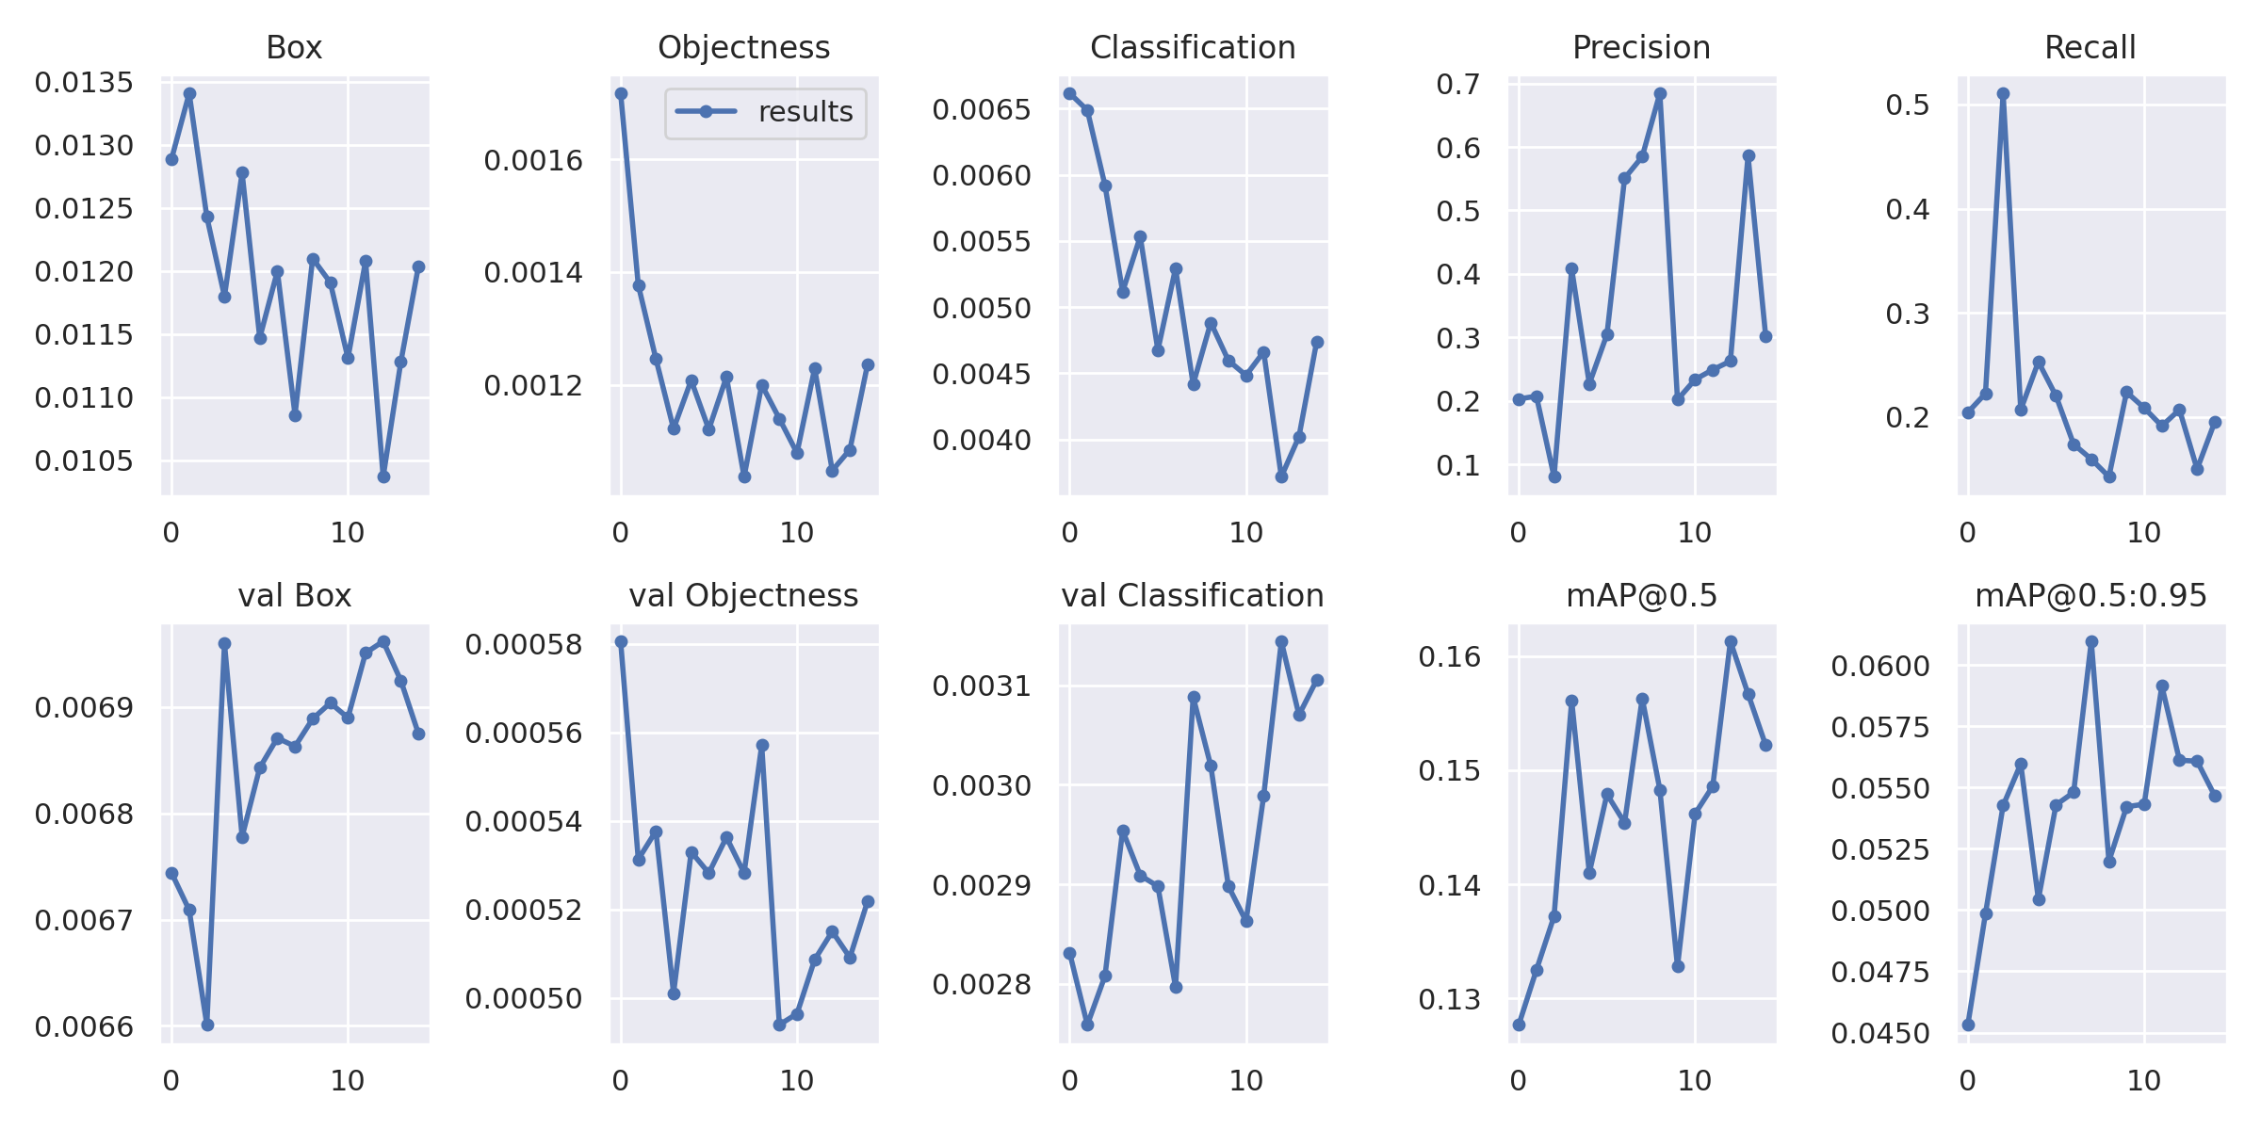

Model_0 Results

Slide 10
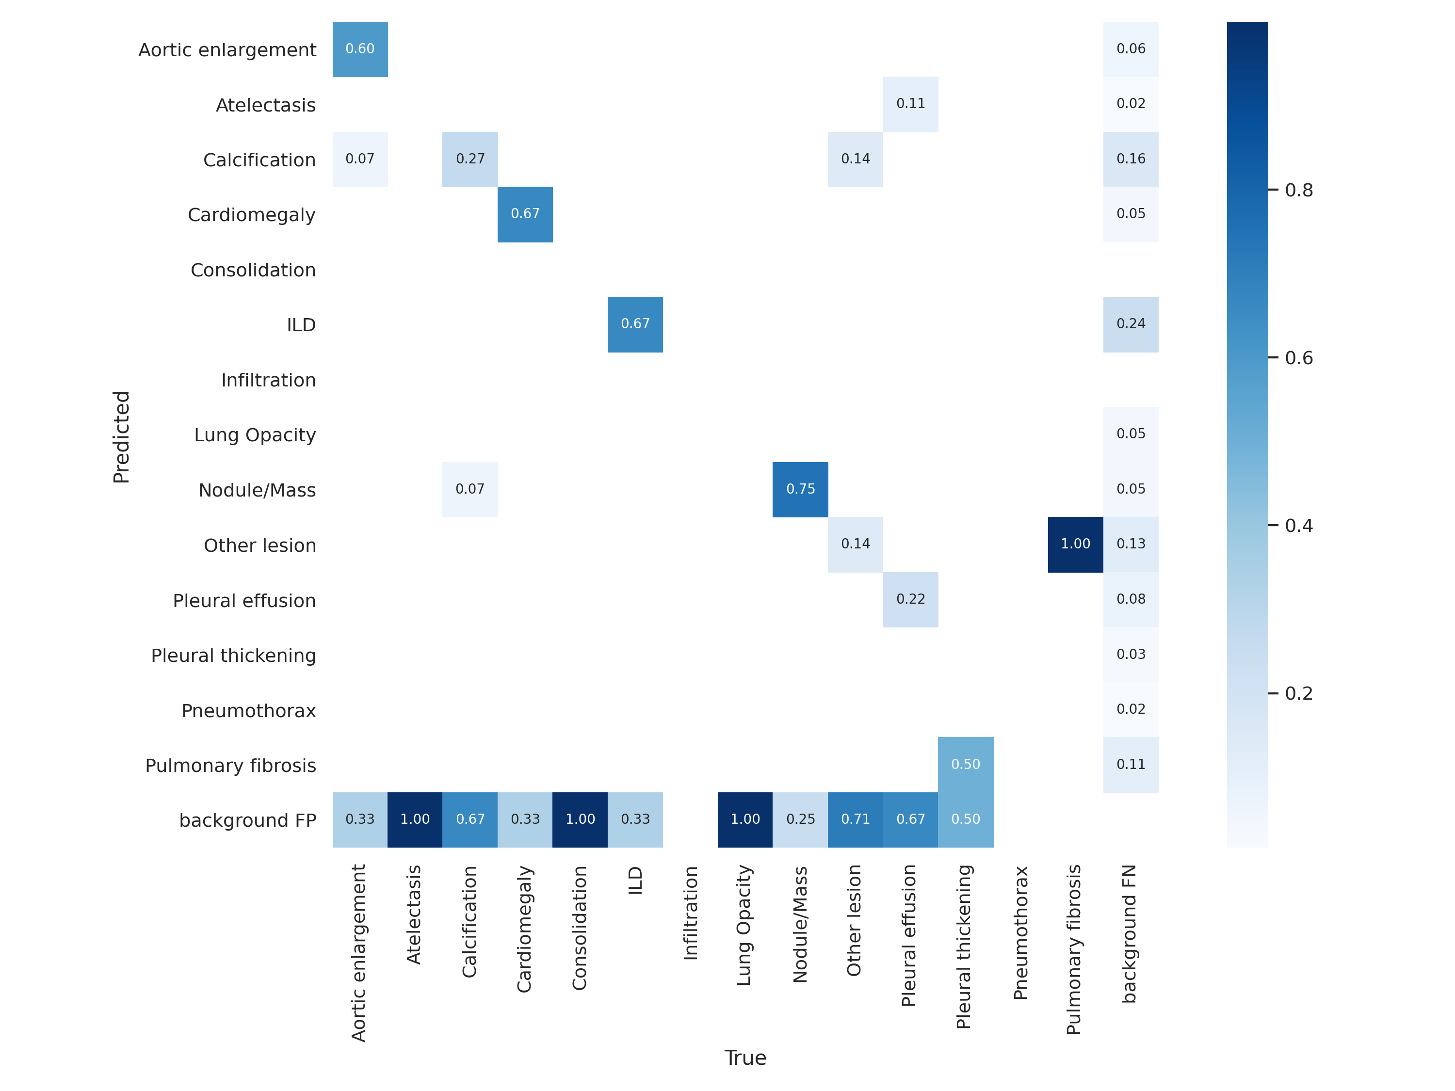
Model_0 Results

Slide 11
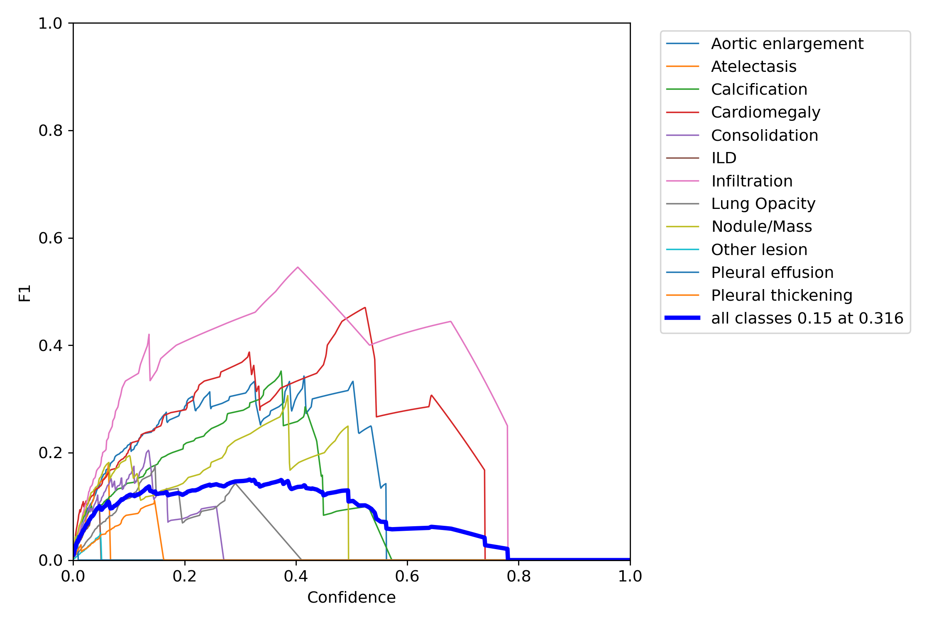
Model_0 Results

Slide 12
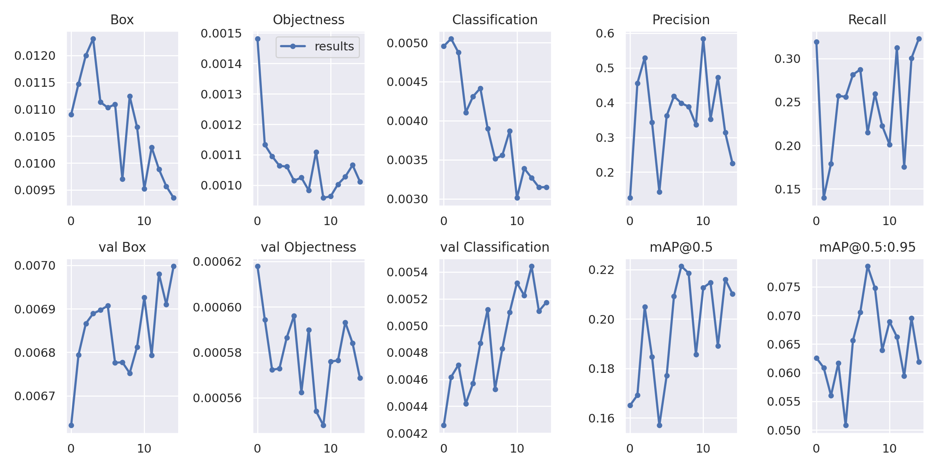
Model_1 Results

Slide 13
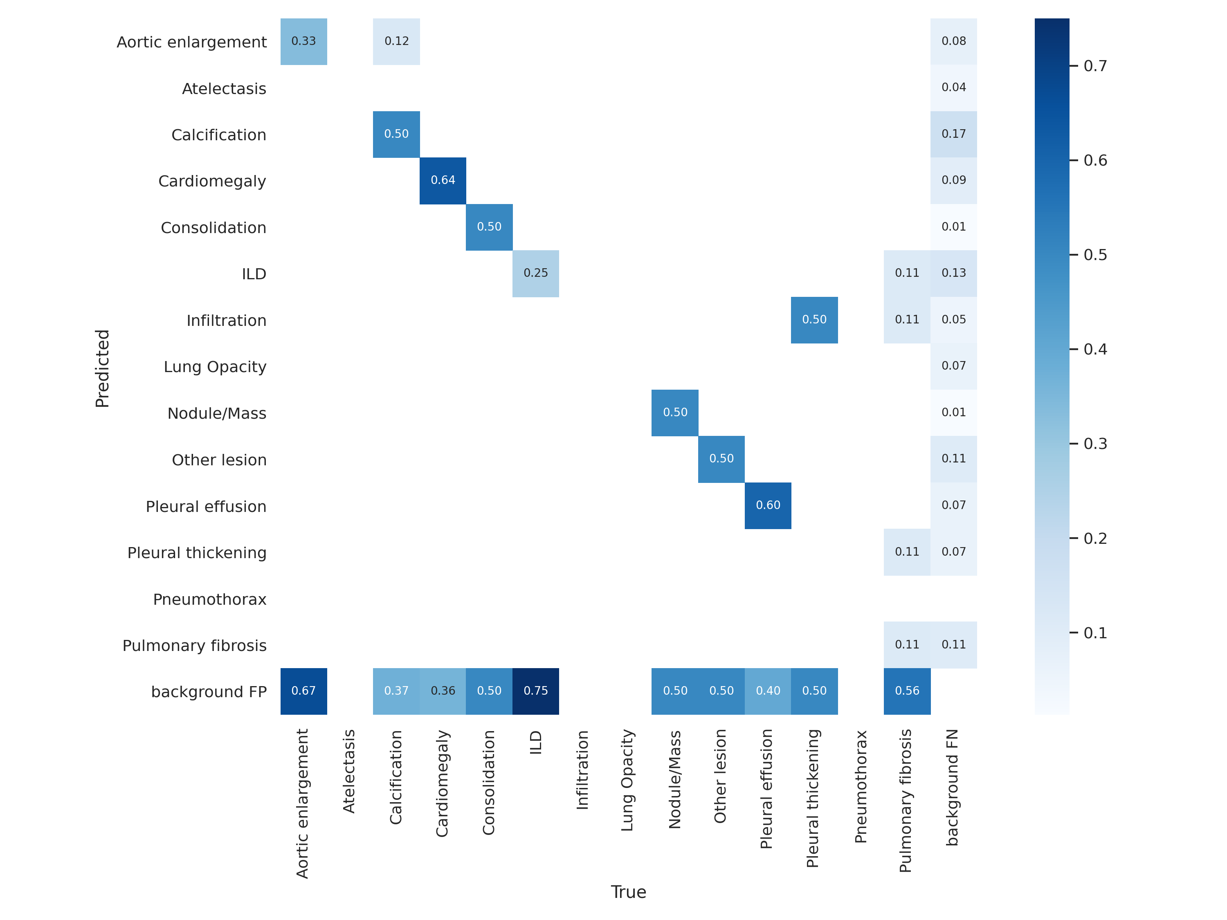
Model_1 Results

Slide 14
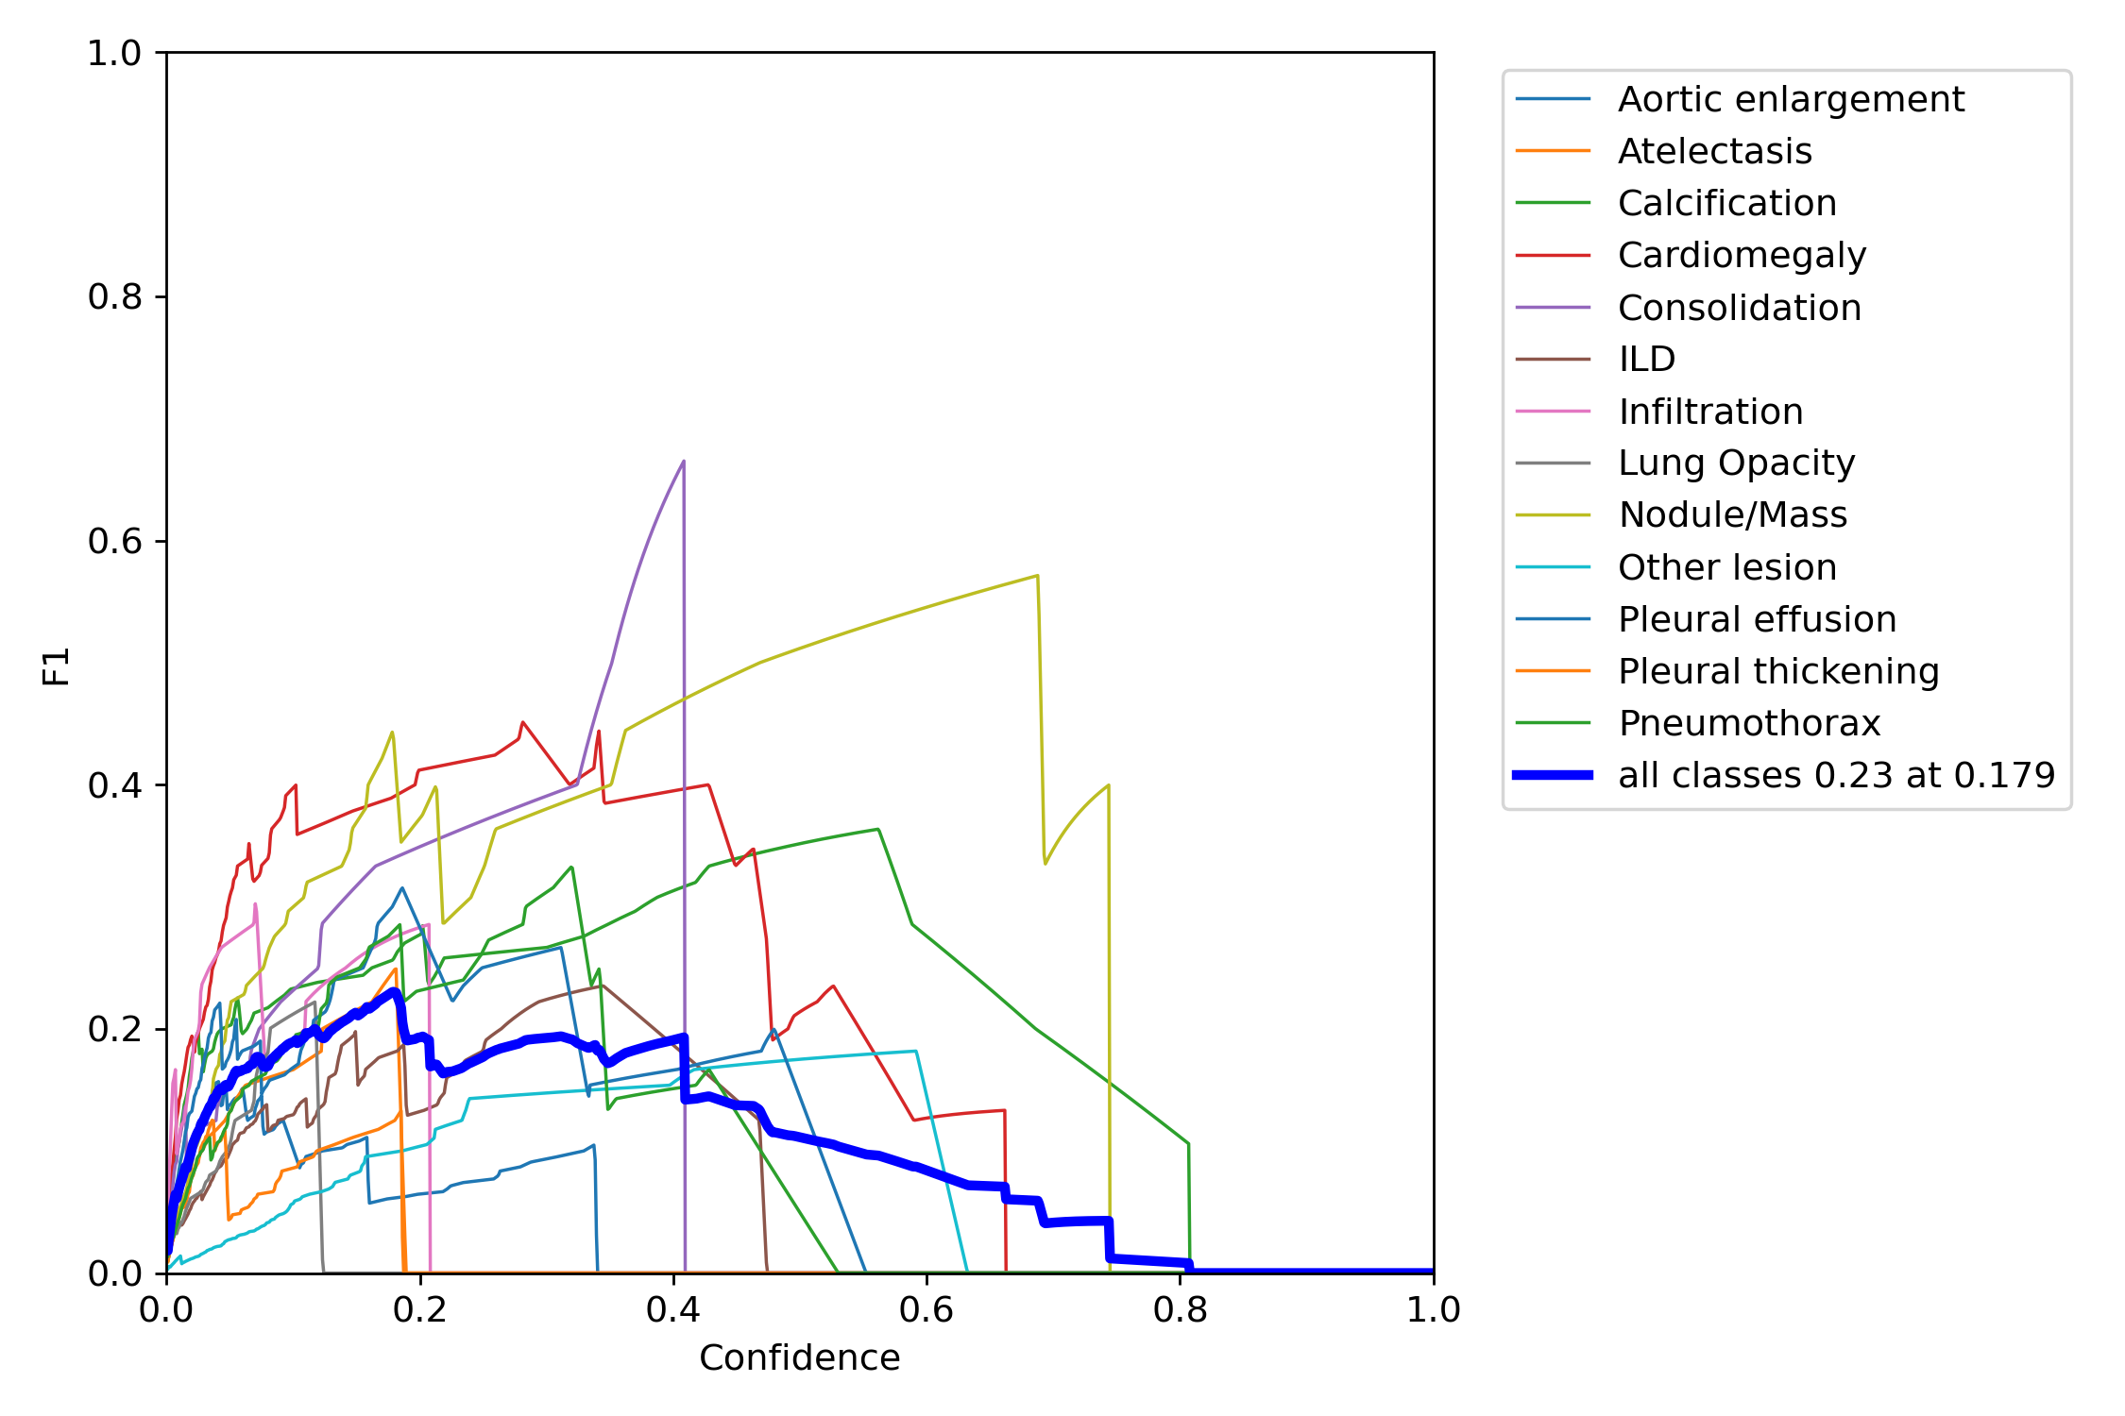
Model_1 Results

Slide 15
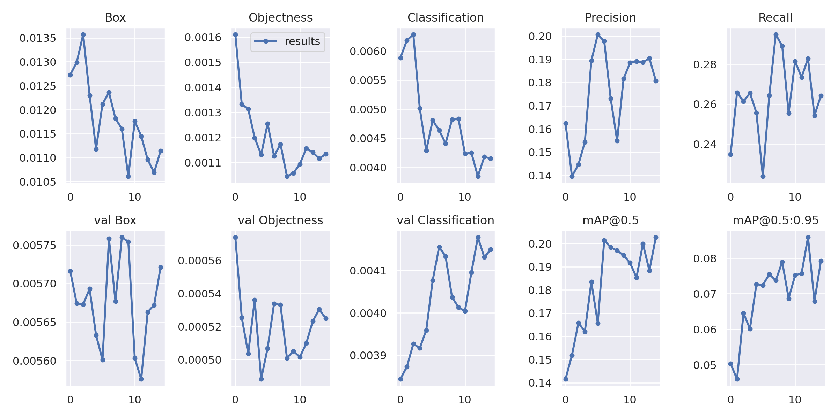
Model_2 Results

Slide 16
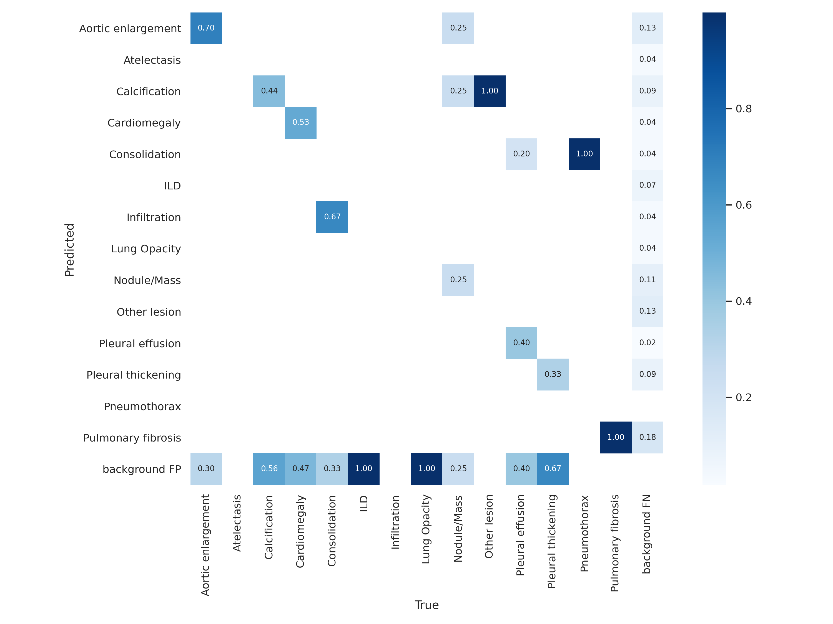
Model_2 Results

Slide 17
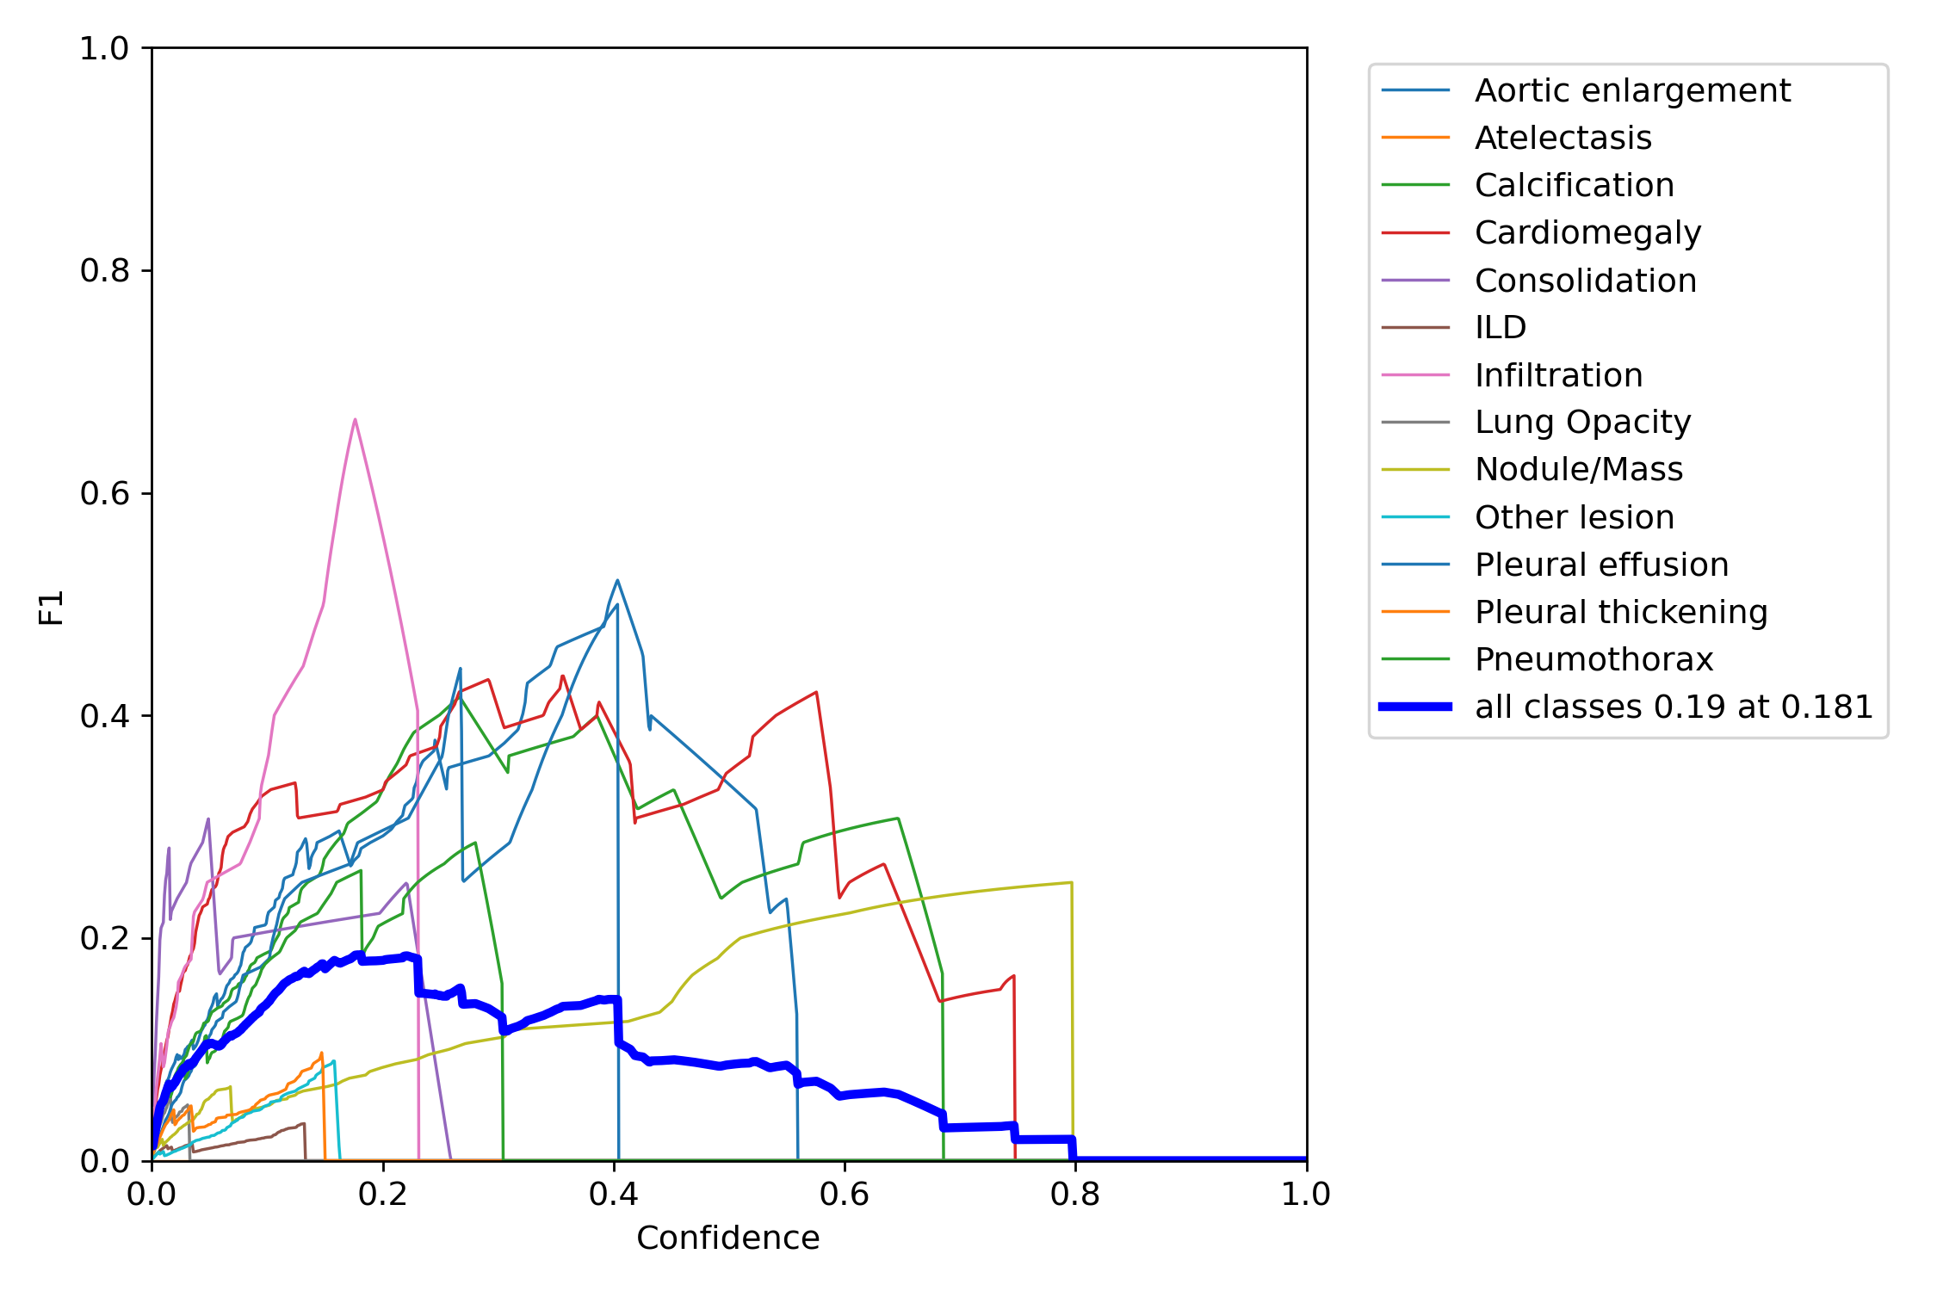
Model_2 Results

Slide 18
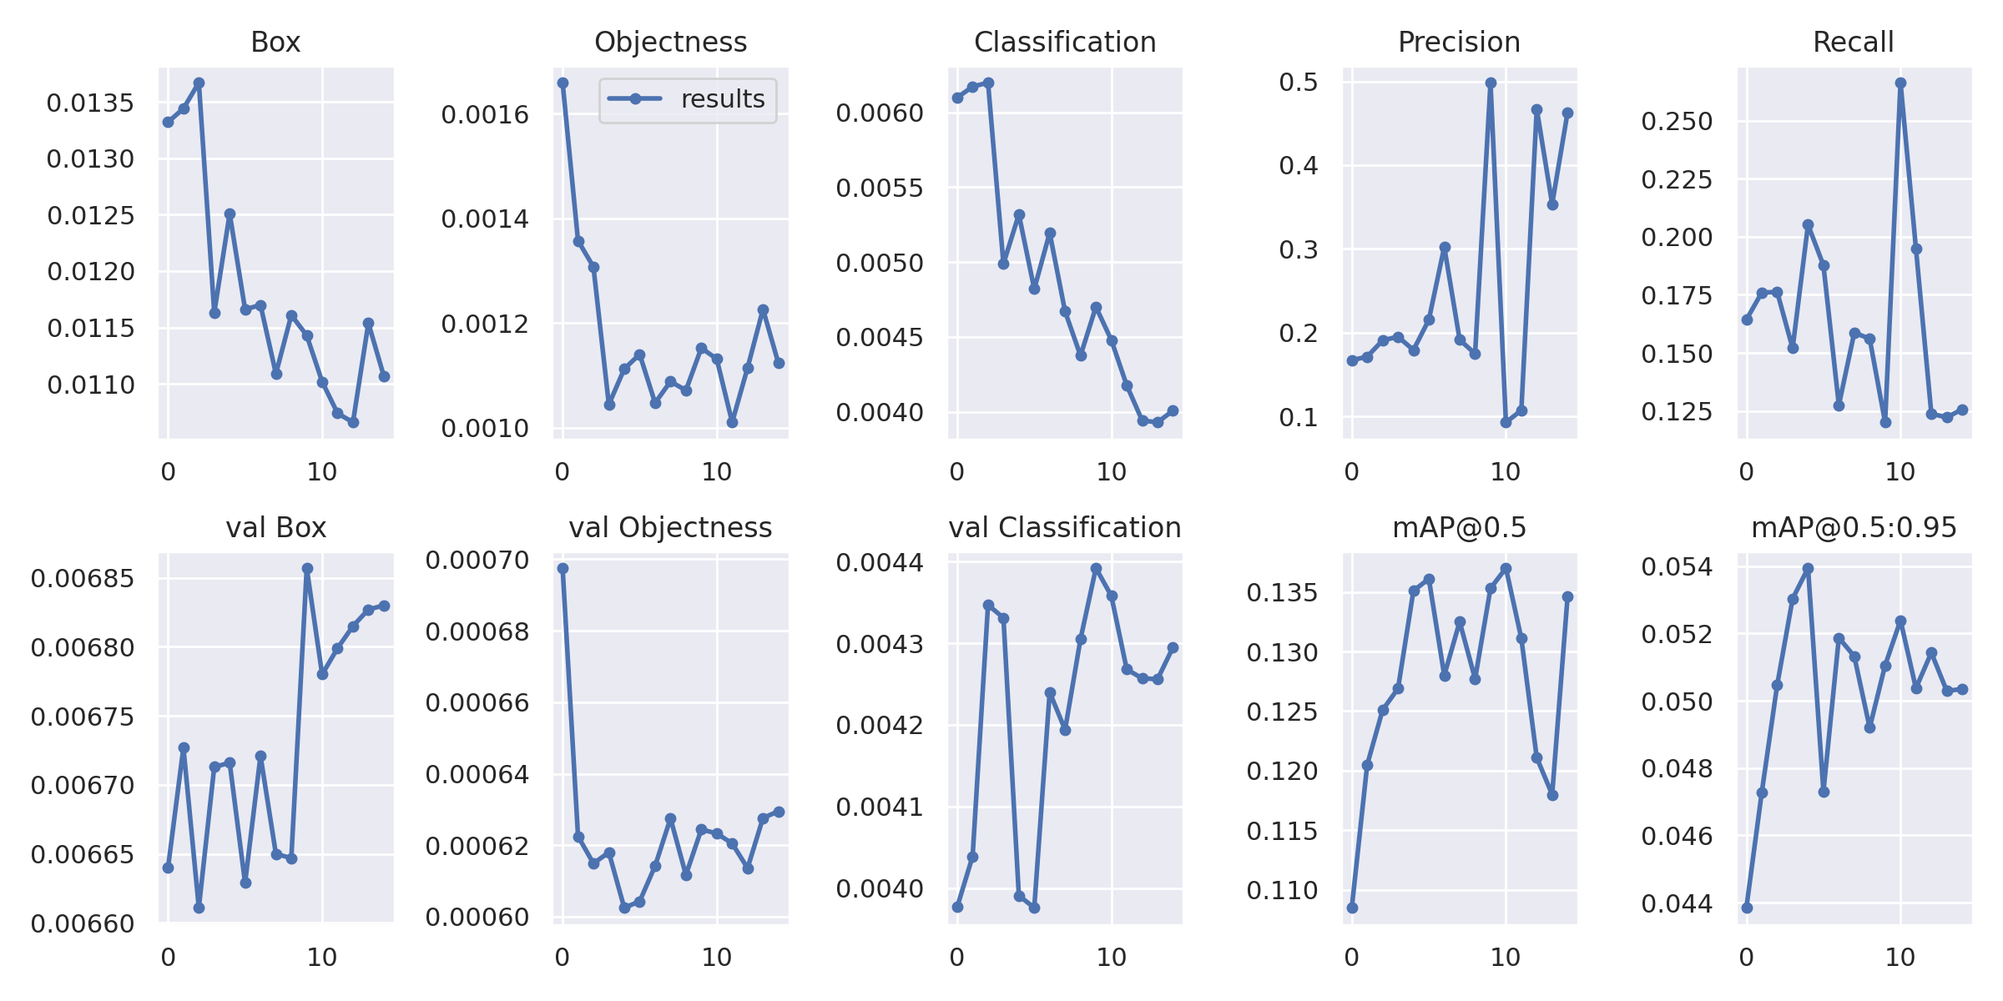
Model_3 Results

Slide 19
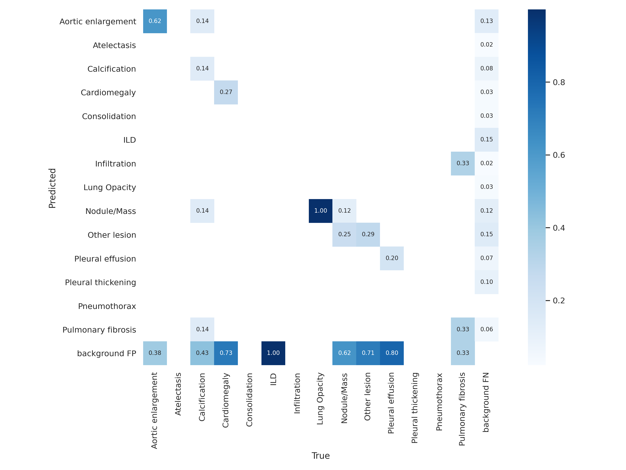
Model_3 Results

Slide 20
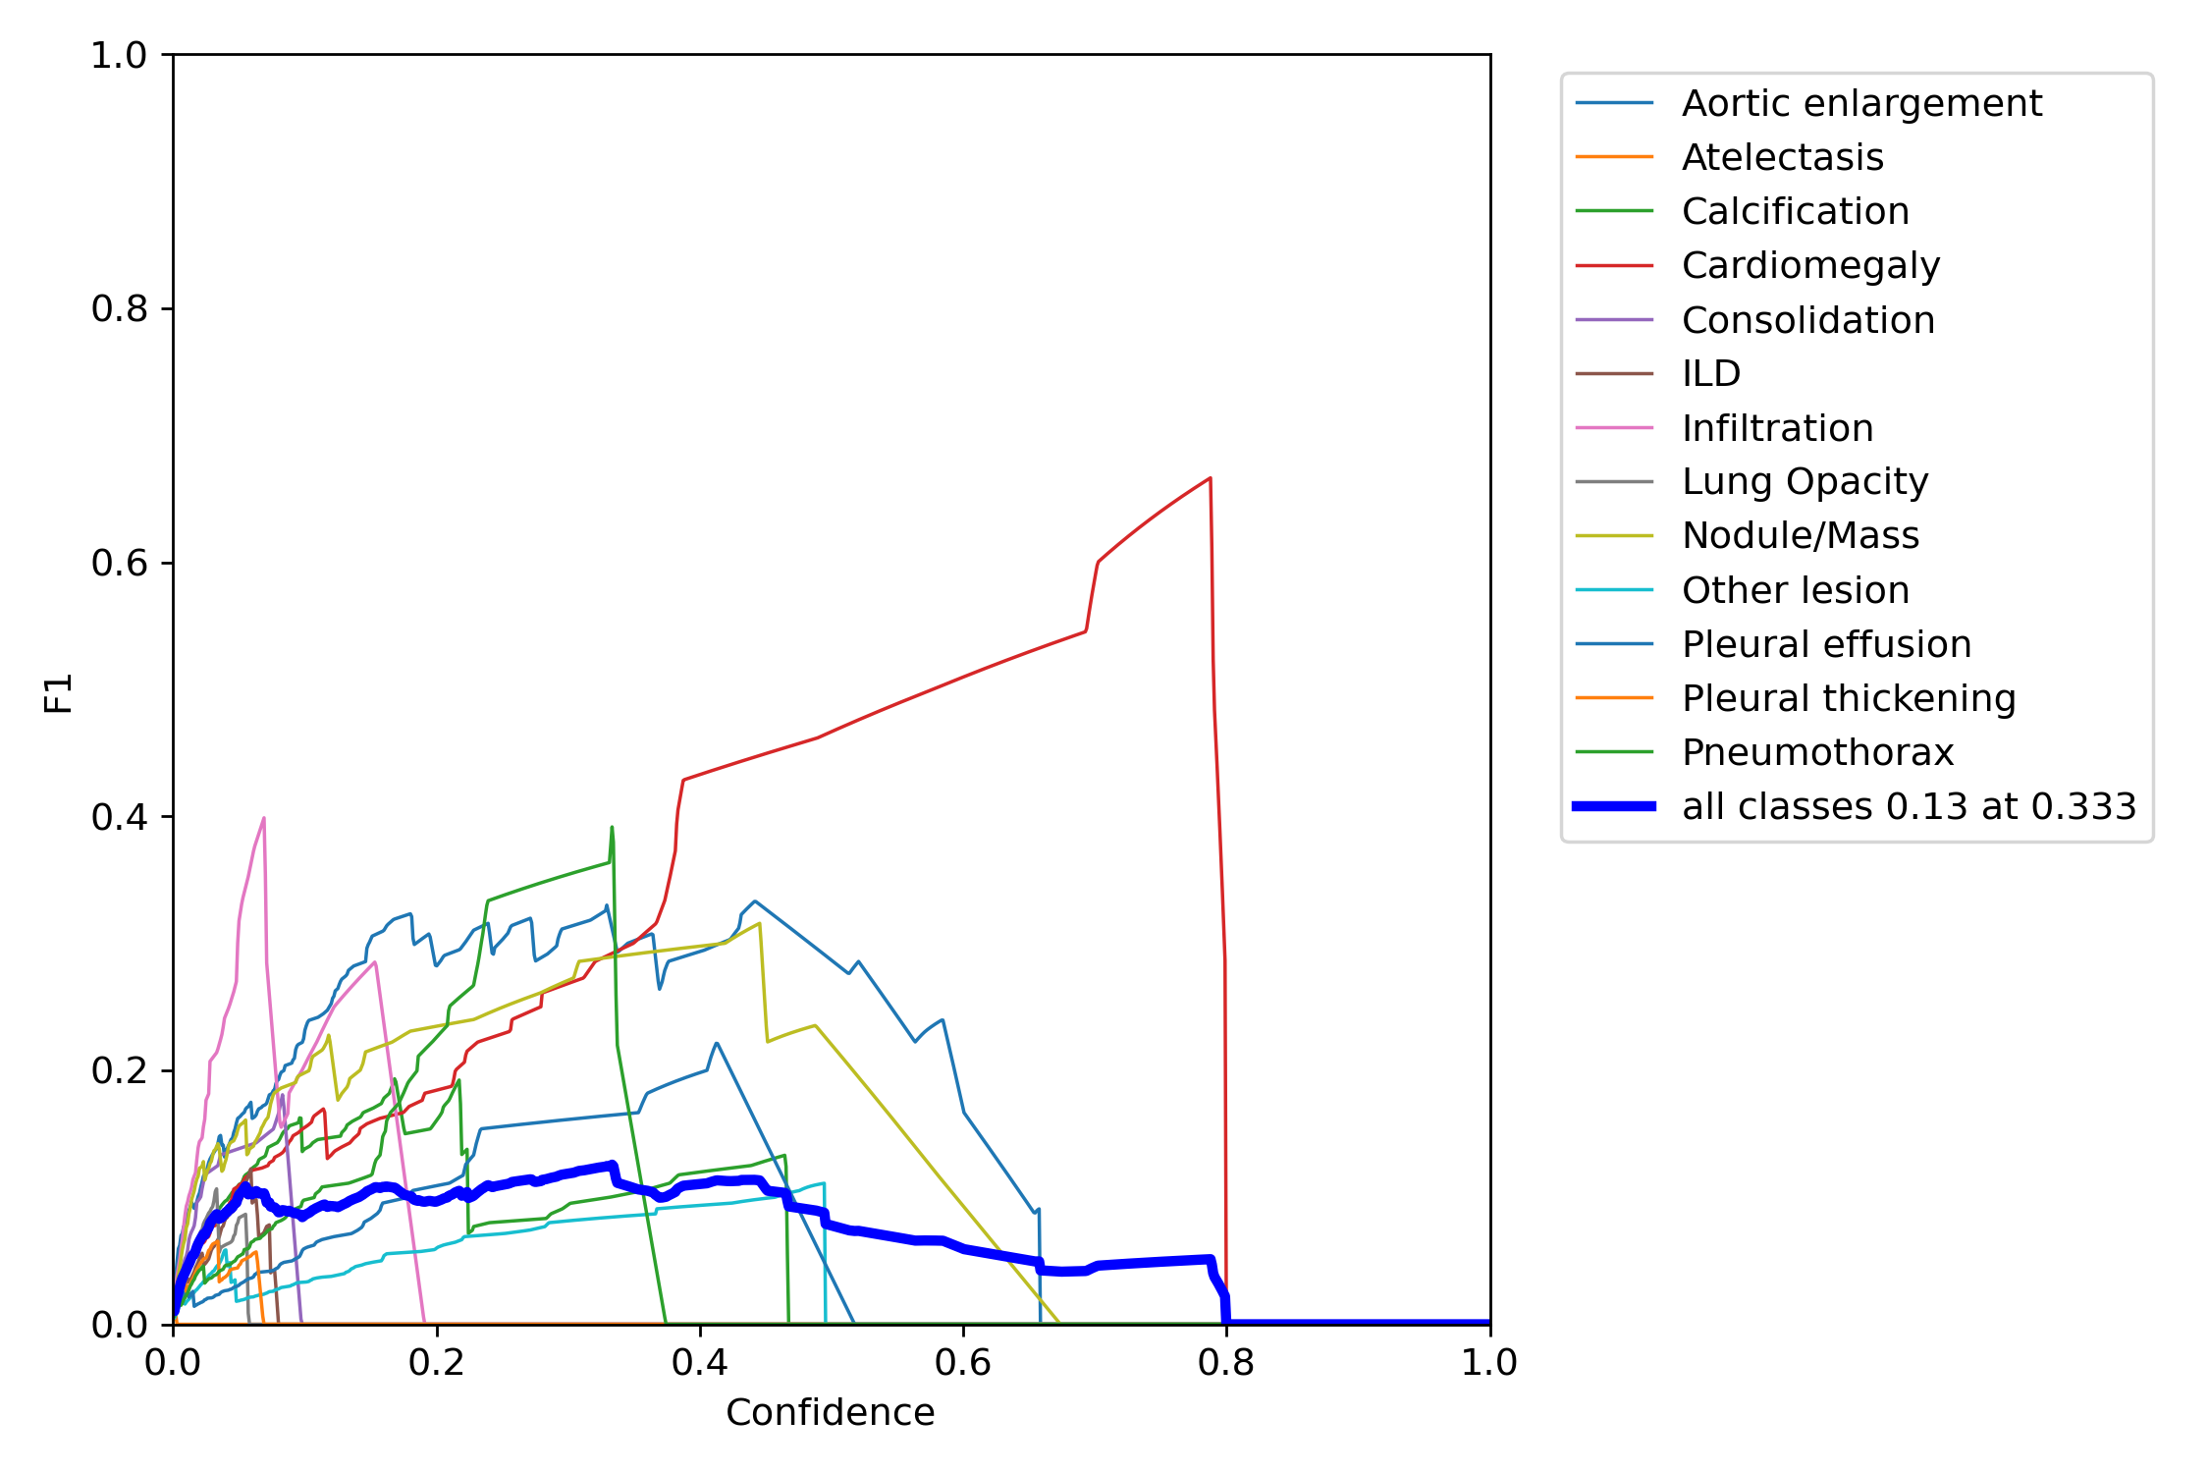
Model_3 Results

Slide 21
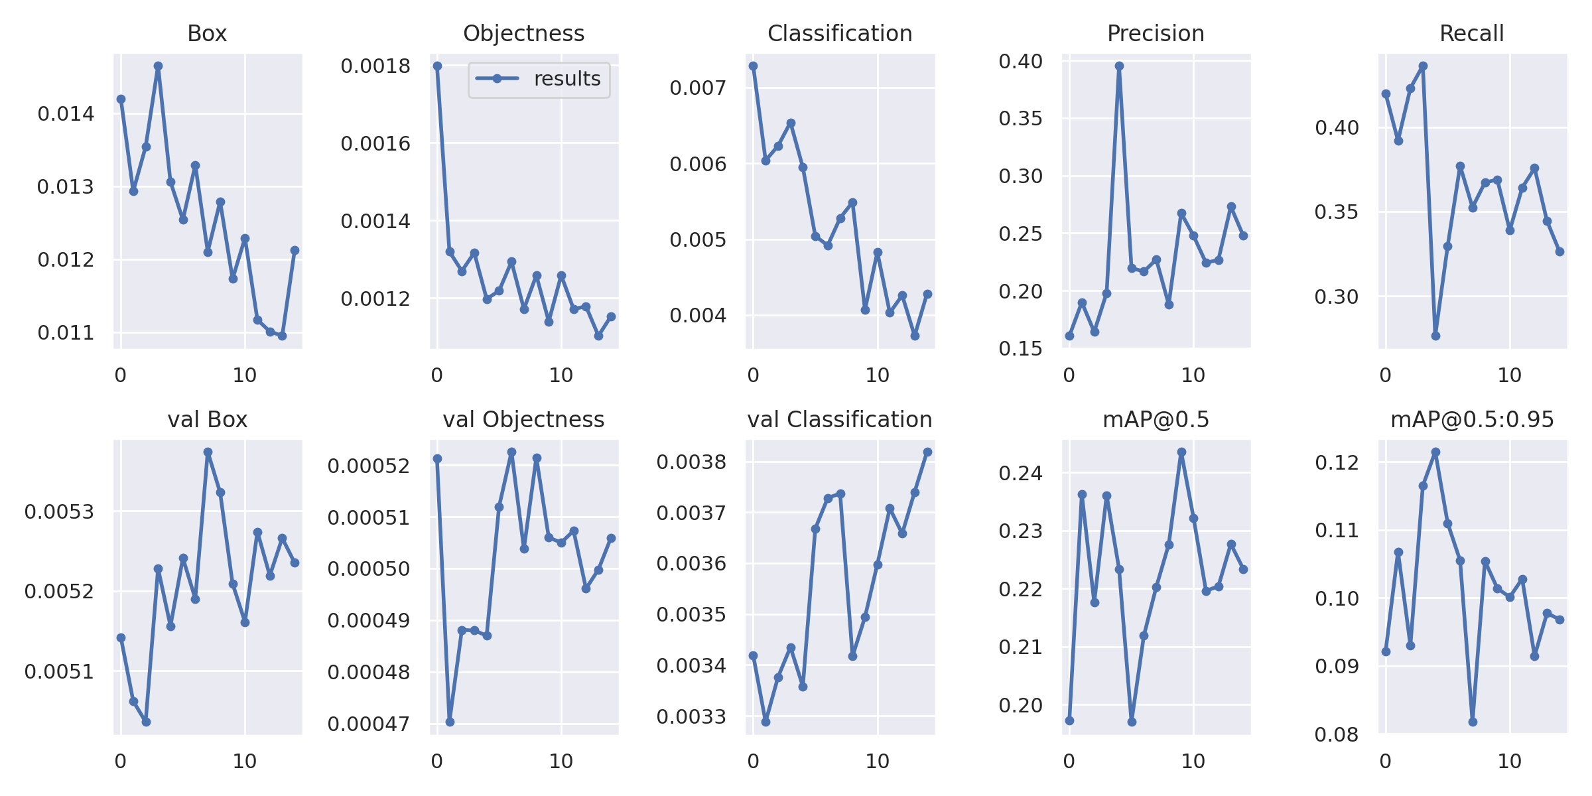
Model_4 Results

Slide 22
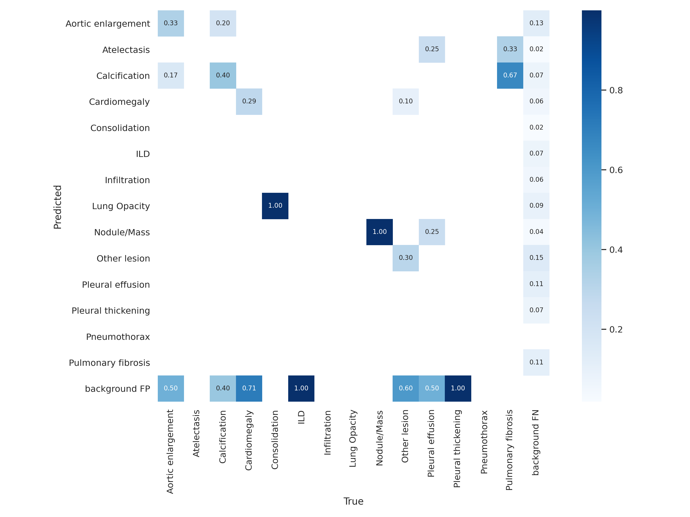
Model_4 Results

Slide 23
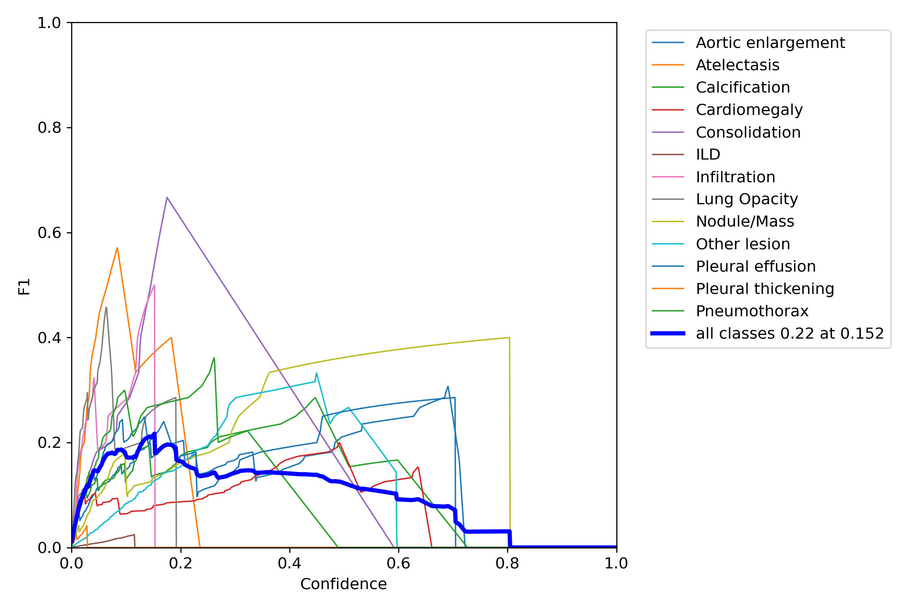
Model_4 Results

Slide 24
Ensemble
Generated results on test dataset with each model:
Image Size : 640
Iou-thres: 0.25
Conf-thres: 0.01
Weight: best.pt (having best mAP on validation)
Use WBF to ensemble all generated results:
Iou_thres : 0.4
Skip_box_thres: 0.0001

Slide 25
Results
Test each model on Kaggle test data
Generated results with Ensemble method
Found public score : 0.201
Private score: 0.212

Slide 26
Thank You

